Slide 1
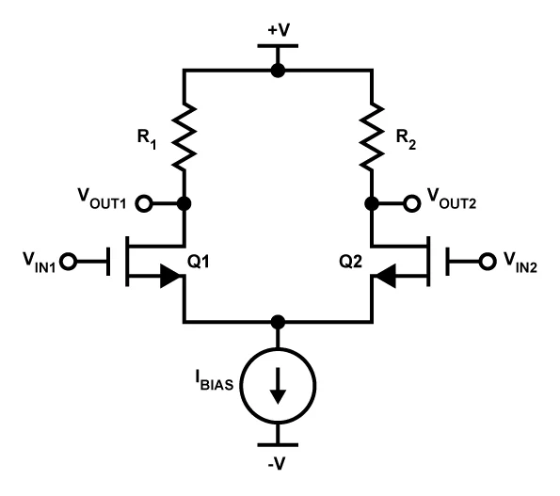
MOSFET Differential Amplifiers

Slide 2
Common-Mode and Differential-Mode Signals & Gain

Slide 3
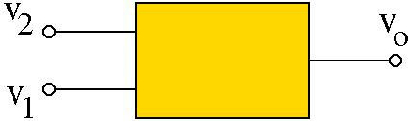
Differential and Common-Mode Signals/Gain
Consider a linear circuit
with TWO inputs
By superposition:
v_{o} = A₁ ⋅ v₁ + A₂ ⋅ v₂
v_{d} = v₂ − v₁
v
Define:
Difference (or differential) Mode
v₁ = v_{c} −
d
2
v_{d}
v + v
v =
1
2
Common Mode
c
2
v₂ = v_{c} +
2
v_{d}
v_{d}
Substituting for v₁ = v_{c} − ₂
and v₂ = v_{c} + ₂
in the expression for v_{o}:
v
⎞
⎛
v
⎞
= (A₁ + A₂ )⋅ v_{c} +
⎛
A₂ − A₁
⎞
v = A ⋅⎛ v −
d
A ⋅ v +
d
⋅ v
⎜ ₂ ⎟
⎜
₂ ⎟
⎜
⎟
o 1
⎝
c
⎠
2
⎝
c
⎠
⎝
2
⎠
d
v_{o} = A_{c} ⋅ v_{c} + A_{d} ⋅ v_{d}

Slide 4
Differential and common-mode signal/gain is an alternative way of finding the system response
v_{d} = v₂ − v₁
A_{c} = A₁ + A₂
₌ A₂ − A₁
2
v + v
v =
1 2
A
c
2
d
v_{o} = A₁ ⋅ v₁ + A₂ ⋅ v₂
v_{o} = A_{c} ⋅ v_{c} + A_{d} ⋅ v_{d}
v
A
v₁ = v_{c} −
d
A =
c
A
2
1
2
d
v
A
v₂ = v_{c} +
d
A =
c
A
2
d
2 2
Differential Gain: Common Mode Gain:
Common Mode Rejection Ratio (CMRR)*:
A_{d} A_{c}
|A_{d}|/|A_{c}|
* CMRR is usually given in dB: CMRR(dB) = 20 log (|A_{d}|/|A_{c}|)

Slide 5
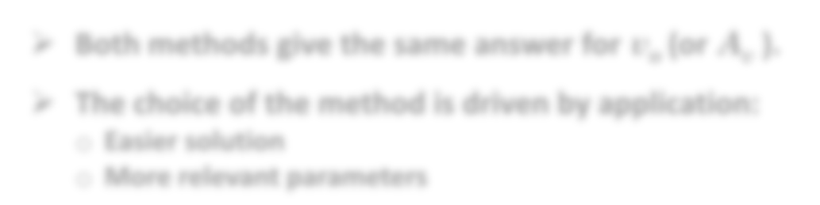

To find v_{o} , we can calculate/measure either A₁ A₂ pair or A_{c} A_{d} pair
Superposition (finding A₁ and A₂ ):
Set v₂ = 0, compute A₁ from
v_{o} = A₁ v₁
Set v₁ = 0, compute A₂ from
v_{o} = A₂ v₂
For any v₁ and v₂ :
v_{o} = A₁ v₁ + A₂ v₂
Difference Method (finding A_{d} and A_{c} ):
1. Set v_{c} = 0 (or set v₁ = − 0.5 v_{d} & v₂ = + 0.5 v_{d}) compute A_{d} from v_{o} = A_{d} v_{d}
Set v_{d} = 0 (or set v₁ = + v_{c} & v₂ = + v_{c} ) compute A_{c} from v_{o} = A_{c} v_{c}
For any v₁ and v₂ : v_{o} = A_{d} v_{d} + A_{c} v_{c}
v_{d} = v₂ − v₁ v_{c} = 0.5(v₁ + v₂ )
Both methods give the same answer for v_{o} (or A_{v} ).
The choice of the method is driven by application:
Easier solution
More relevant parameters

Slide 6
MOSFET Differential Amplifiers:

Slide 7
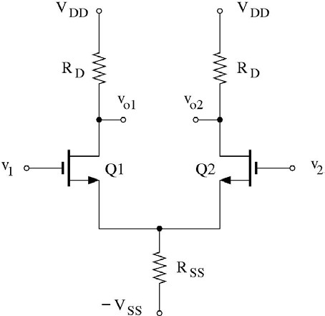
Differential Amplifier
Identical transistors.
Circuit elements are symmetric about the mid-plane.
Identical bias voltages at Q1 & Q2 gates (V_{G1} = V_{G2} ).
Signal voltages & currents are different because v₁ ≠ v₂.
Load R_{D}: resistor, current- mirror, active load, …
Q1 & Q2 are in CS-like configuration (input at the gate, output at the drain) but with sources connected to each other.
R_{SS}: Bias resistor, current source (current-mirror)
o For now, we keep track of “two” output, v_{o1} and v_{o2} , because there are several ways to configure “one” output from this circuit.

Slide 8
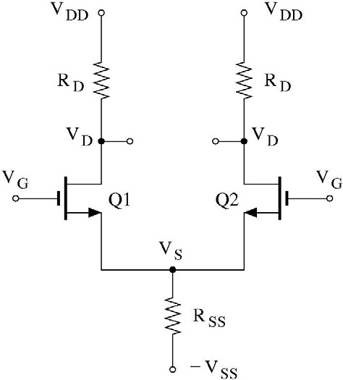
Differential Amplifier – Bias
Since V_{G1} = V_{G 2} = V_{G}
and V_{S1} = V_{S 2} = V
I_{D}
I_{D}
S
^{V}GS1 ^{= V}GS 2 ^{= V}GS
^{V}D1 ^{= V}D2 ^{= V}D
I_{D1} = I_{D2} = I_{D}
^{V}DS1 ^{= V}DS2 ^{= V}DS
I_{D}
I_{D}
2I_{D}
Also:
g_{m1} = g_{m2} = g_{m}
r_{o1} = r_{o 2} = r_{o}

Slide 9
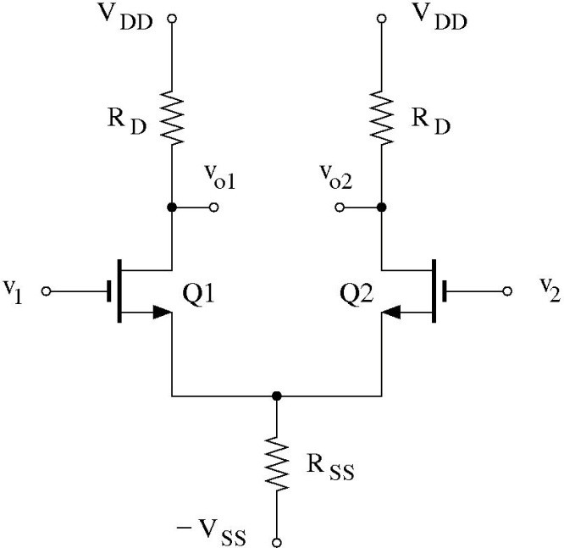
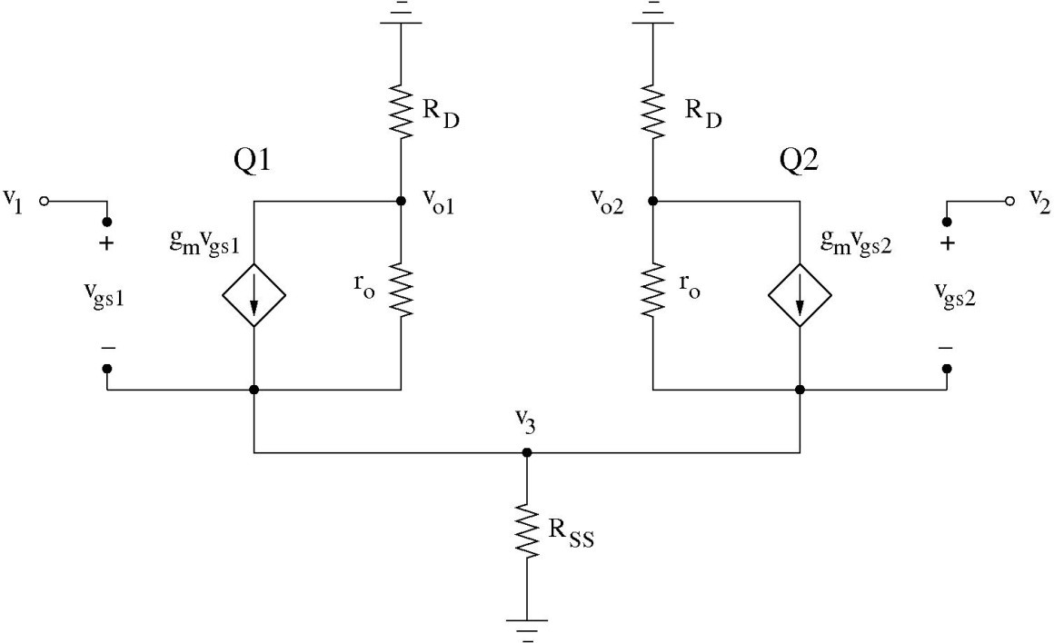
Differential Amplifier – Gain
Signal voltages & currents are different because v₁ ≠ v₂
We cannot use fundamental amplifier configuration for arbitrary values of v₁ and v₂.
We have to replace each NMOS with its small-signal model.

Slide 10
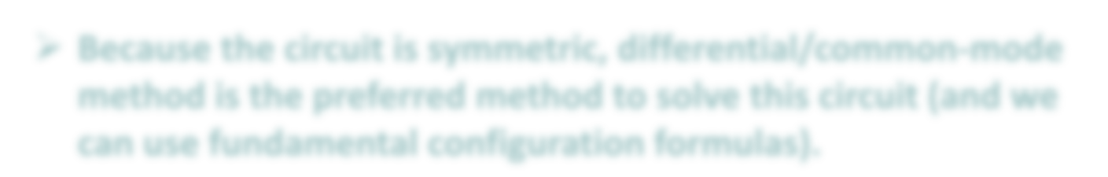

Differential Amplifier – Gain
^{v}gs1 ^{= v}1 ^{− v}3
^{v}gs 2 ^{= v}2 ^{− v}3
Node Voltage Method:
Node v_{o1}:
^{v}o1 ₊ ^{v}o1 ^{− v}3
+ g (v − v ) = 0
R r
m 1 3
D o
Node v_{o2}: ^{vo 2}
^{v}o 2 ^{− v}3
+ g_{m} (v₂ − v₃ ) = 0
R
r
D
o
Node v₃:
v₃
₊ ^{v}3 ^{− v}o 2 ₊ ^{v}3 ^{− v}o1
− g_{m} (v₁ − v₃ ) − g_{m} (v₂ − v₃ ) = 0
R
r r
SS o o
Above three equations should be solved to find v_{o1} , v_{o2} and v₃ (lengthy calculations)
Because the circuit is symmetric, differential/common-mode method is the preferred method to solve this circuit (and we can use fundamental configuration formulas).

Slide 11
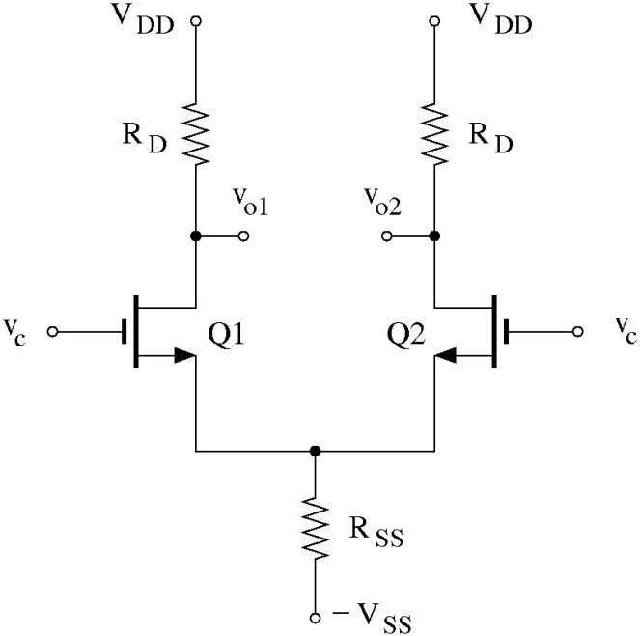
Differential Amplifier – Common Mode (1)
Common Mode: Set v_{d} = 0 (or set v₁ = + v_{c} and v₂ = + v_{c} )
v
A
v₁ = v_{c} −
d
A =
c
A
2
1
2
d
v
A
i_{d}
v₂ = v_{c} +
d
A =
c
A
2
d
2 2
Because of summery of
the circuit and input signals*:
^{v}o1 ^{= v}o 2
and i_{d1} = i_{d 2} = i_{d}
i_{d}
i_{d}
2i_{d}
We can solve for v_{o1} by node voltage method but there is a simpler and more elegant way.
* If you do not see this, set v₁ = v₂ = v_{c} in node equations of the previous slide, subtract the first two equations to get v_{o1} = v_{o2} . Ohm’s law on R_{D} then gives i_{d1} = i_{d2} = i_{d}

Slide 12
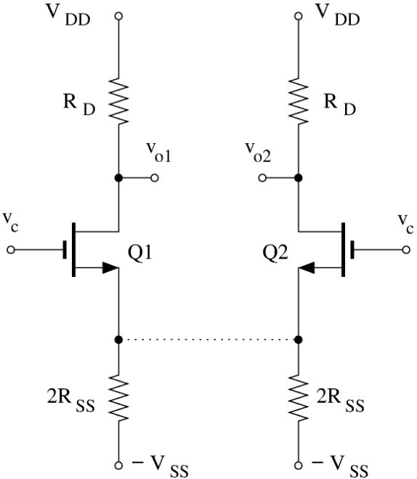
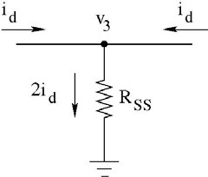
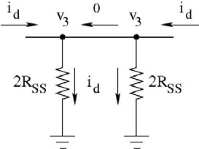
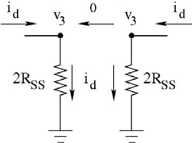


Differential Amplifier – Common Mode (2)
i_{d}
i_{d}
0
i_{d}
i_{d}
2i_{d}
i_{d}
v₃ = 2i_{d} R_{SS} *
Because of the symmetry, the common-mode circuit breaks into two identical “half-circuits”.
* V_{ss} is grounded for signal

Slide 13


Differential Amplifier – Common Mode (3)
The common-mode circuit breaks into two identical half-circuits.
0

Slide 14
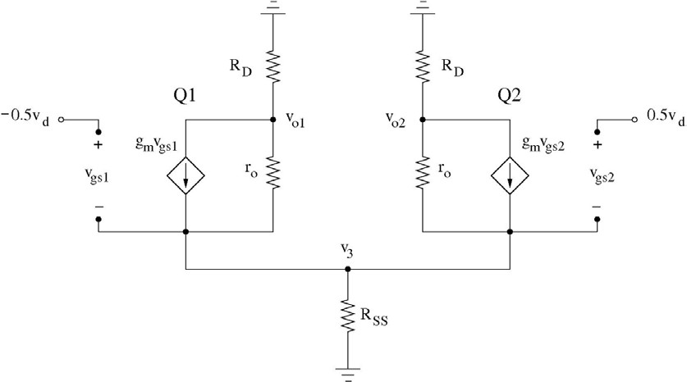
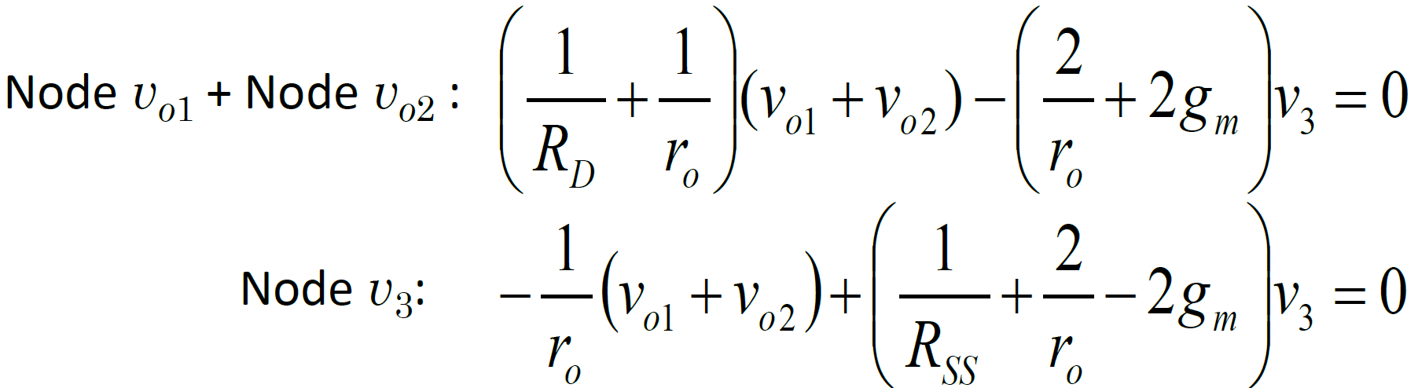
Differential Amplifier – Differential Mode (1)
Differential Mode: Set v_{c} = 0 (or set v₁ = − v_{d} /2 and v₂ = + v_{d} /2 )
v_{gs1} = −0.5v_{d} − v₃ v_{gs 2} = +0.5v_{d} − v₃
Node Voltage Method:
Node v_{o1}:
^{v}o1 ₊ ^{v}o1 ^{− v}3
+ g_{m} (−0.5v_{d} − v₃ ) = 0
R r
D o
Node v_{o2}:
^{v}o 2 ₊ ^{v}o 2 ^{− v}3
+ g_{m} (+0.5v_{d} − v₃ ) = 0
R
r
D
o
Node v₃:
v₃
₊ ^{v}3 ^{− v}o 2 ₊ ^{v}3 ^{− v}o1
− g_{m} (−0.5v_{d} − v₃ ) − g_{m} (+0.5v_{d} − v₃ ) = 0
R
r r
SS
o o
Only possible solution:
v_{o1} + v_{o 2} = 0 ⇒ v_{o1} = −v_{o 2}
v₃ = 0

Slide 15
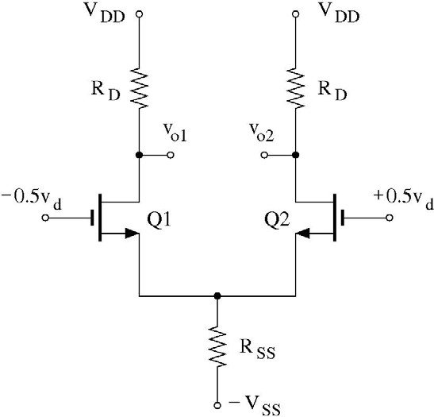
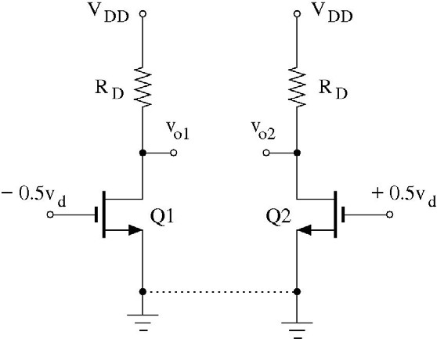

Differential Amplifier – Differential Mode (2)
v₃ = 0 and v_{o1} = −v_{o 2} ⇒ i_{d1} = −i_{d 2}
i_{d}
i_{d}
i_{d}
i_{d}
v₃ = 0
v₃ = 0
i_{d}
i_{d}
0
CS Amplifier
^{v}o1
= −g_{m} (r_{o} ||R_{D} ) ,
^{v}o 2
= −g_{m} (r_{o} ||R_{D} )
− 0.5v
+ 0.5v
d d
Because of the symmetry, the differential-mode circuit also breaks into two identical half-circuits.

Slide 16


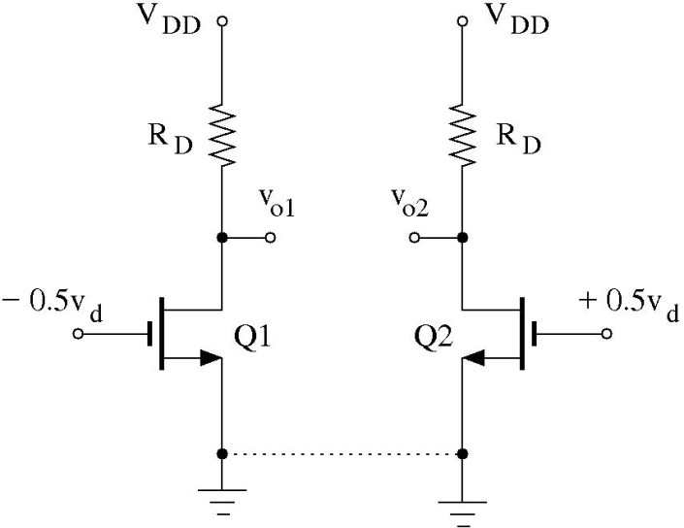
Concept of “Half Circuit”
For a symmetric circuit, differential- and common-mode analysis can be performed using “half-circuits.”
Common Mode
Differential Mode

Slide 17
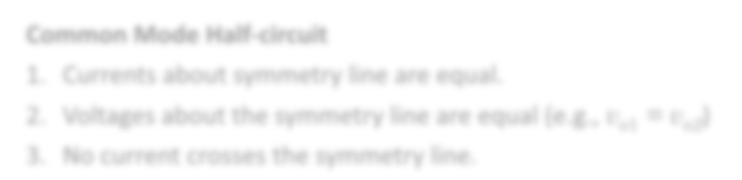

Common-Mode “Half Circuit”
Common Mode circuit
i_{d} i_{d}
^{v}o1 ^{= v}o 2
0
^{v}s1 ^{= v}s 2
i_{d} i_{d}
Common Mode Half-circuit
Currents about symmetry line are equal.
Voltages about the symmetry line are equal (e.g., v_{o1} = v_{o2})
No current crosses the symmetry line.

Slide 18

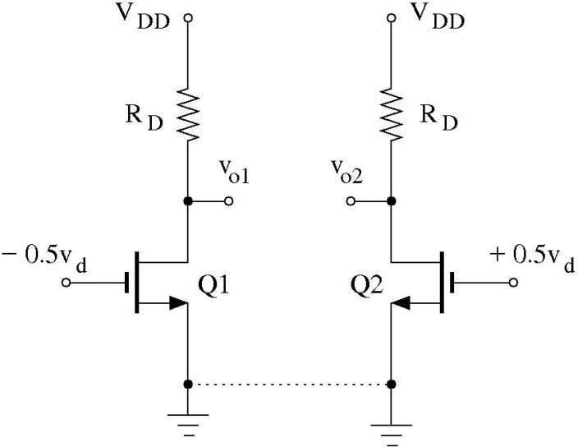
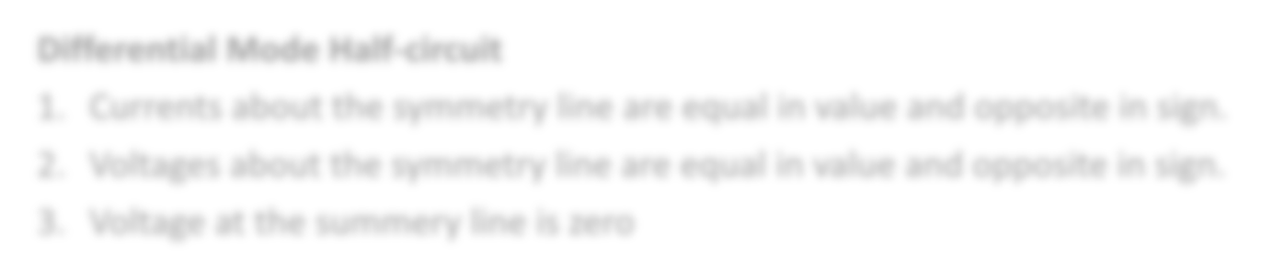

Differential-Mode “Half Circuit”
Differential Mode circuit
i_{d}
i_{d}
v_{o1} = −v_{o 2}
v_{s1} = v_{s 2} = 0
i_{d}
i_{d}
Differential Mode Half-circuit
Currents about the symmetry line are equal in value and opposite in sign.
Voltages about the symmetry line are equal in value and opposite in sign.
Voltage at the summery line is zero

Slide 19
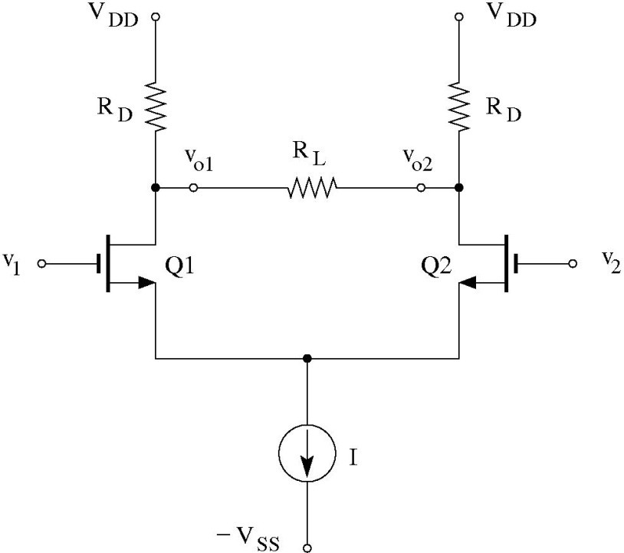
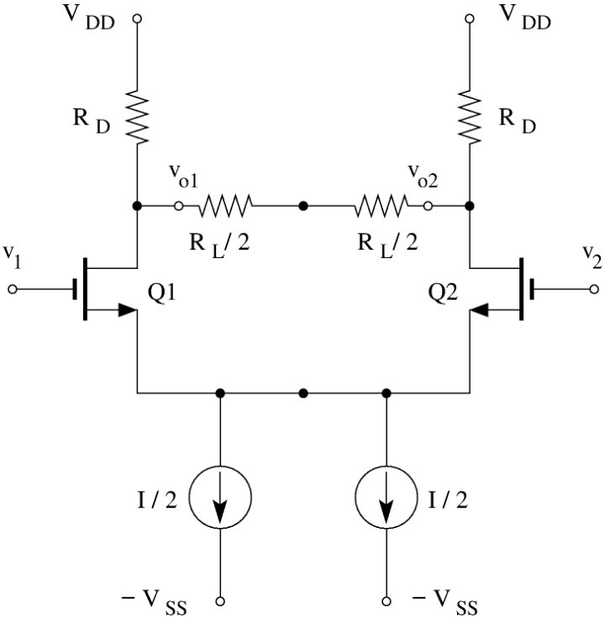
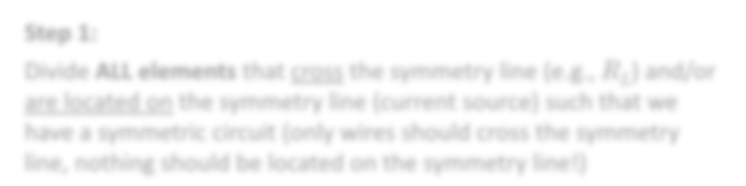

Constructing “Half Circuits”
Step 1:
Divide ALL elements that cross the symmetry line (e.g., R_{L}) and/or are located on the symmetry line (current source) such that we have a symmetric circuit (only wires should cross the symmetry line, nothing should be located on the symmetry line!)

Slide 20
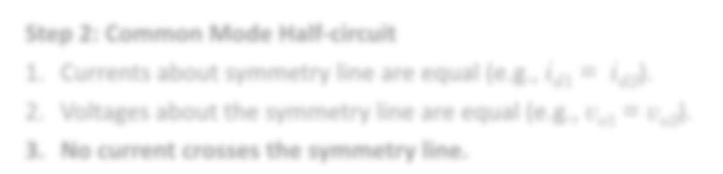

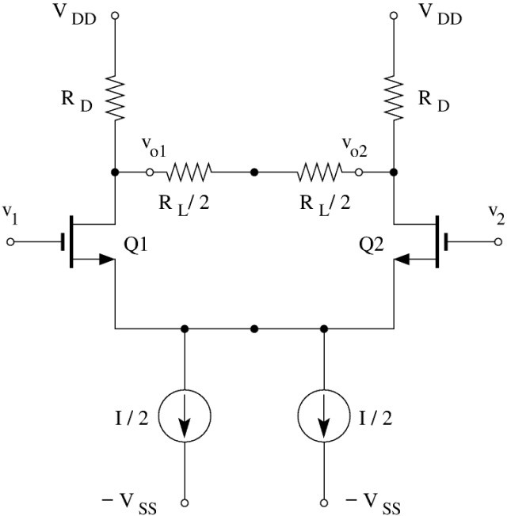
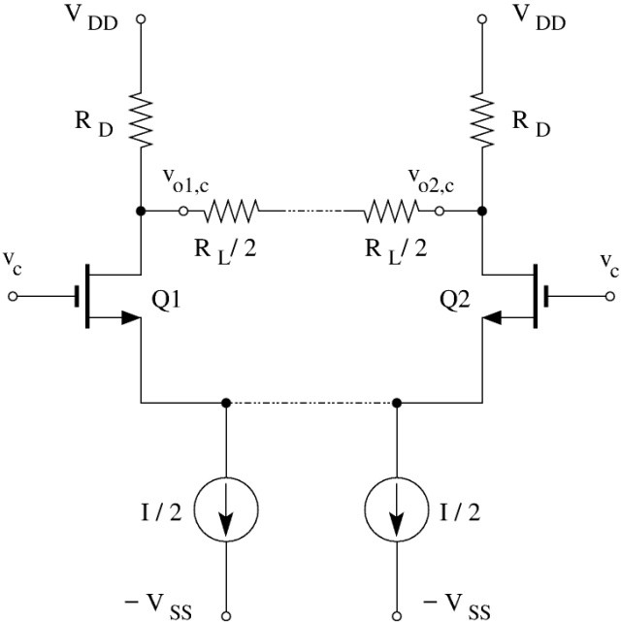
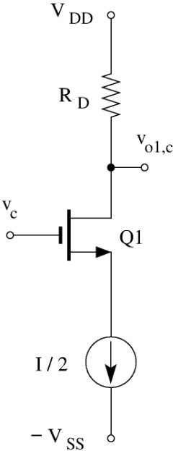
Constructing “Half Circuit”– Common Mode
Step 2: Common Mode Half-circuit
Currents about symmetry line are equal (e.g., i_{d1} = i_{d2}).
Voltages about the symmetry line are equal (e.g., v_{o1} = v_{o2}).
No current crosses the symmetry line.
0
^{v}o1,c ^{= v}o2,c

Slide 21
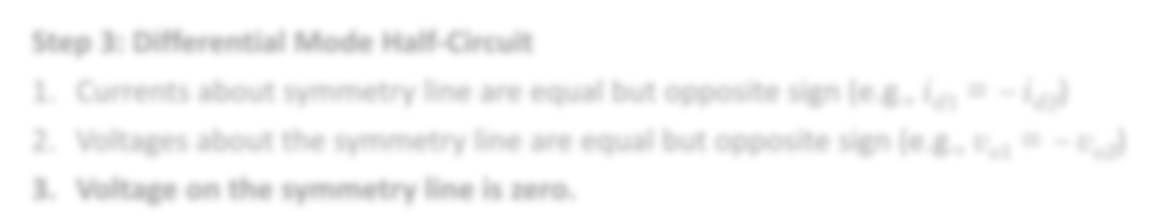

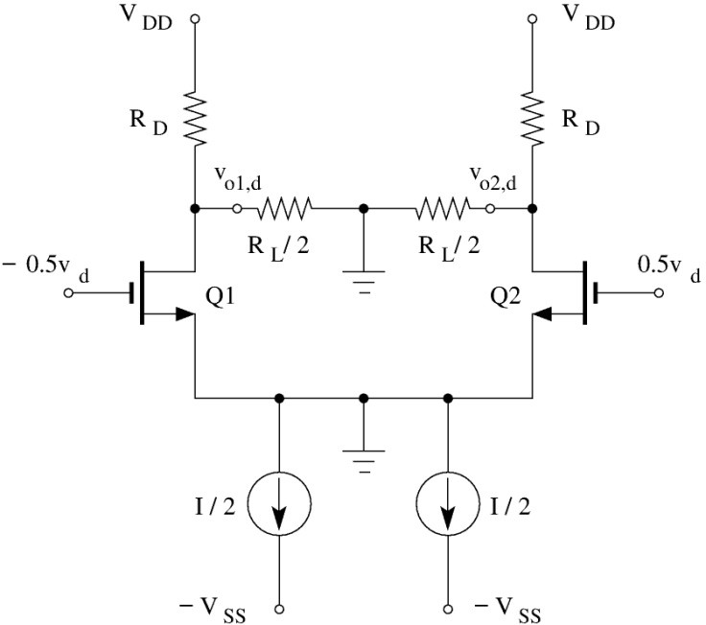
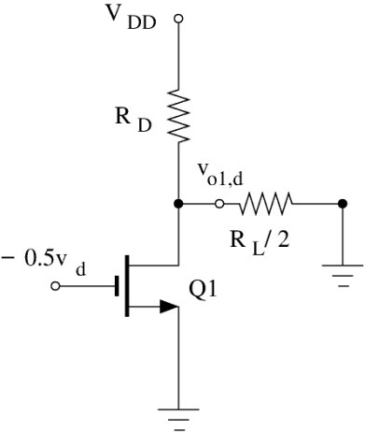
Constructing “Half Circuit”– Differential Mode
Step 3: Differential Mode Half-Circuit
Currents about symmetry line are equal but opposite sign (e.g., i_{d1} = − i_{d2})
Voltages about the symmetry line are equal but opposite sign (e.g., v_{o1} = − v_{o2})
Voltage on the symmetry line is zero.
^{v}o1,d ^{= −v}o 2,d

Slide 22
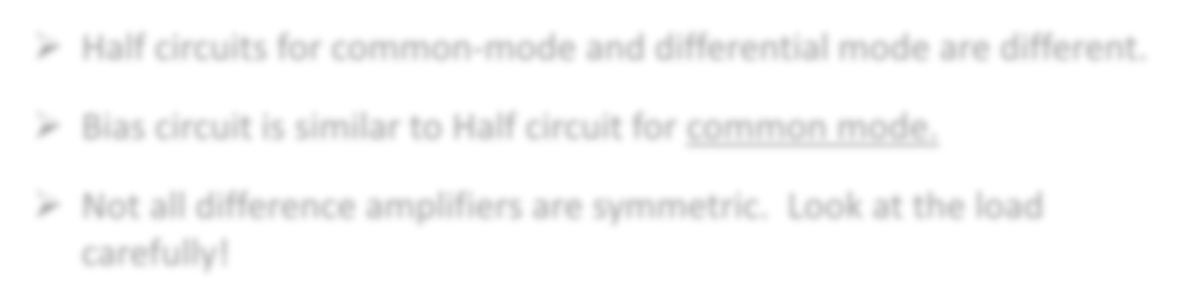

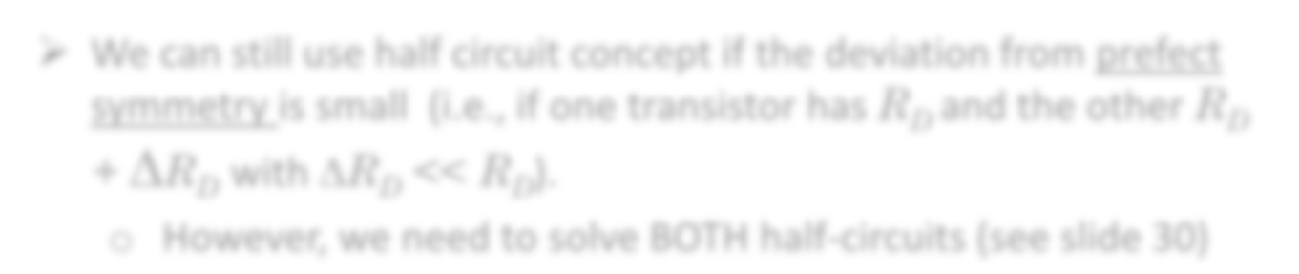

“Half-Circuit” works only if the circuit is symmetric!
Half circuits for common-mode and differential mode are different.
Bias circuit is similar to Half circuit for common mode.
Not all difference amplifiers are symmetric. Look at the load carefully!
We can still use half circuit concept if the deviation from prefect symmetry is small (i.e., if one transistor has R_{D} and the other R_{D}
+ ΔR_{D} with ΔR_{D} << R_{D}).
o However, we need to solve BOTH half-circuits

Slide 23
Why are Differential Amplifiers popular?
They are much less sensitive to noise (CMRR >>1).

Slide 24
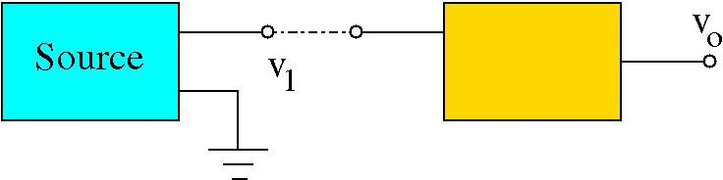
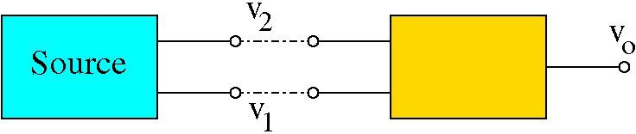
Why is a large CMRR useful?
A major goal in circuit design is to minimize the noise level (or improve signal-to-noise ratio). Noise comes from many sources (thermal, EM, …)
A regular amplifier “amplifies” both signal and noise.
^{v}1 ^{= v}sig ^{+ v}noise
v_{o} = A ⋅ v₁ = A ⋅ v_{sig} + A ⋅ v_{noise}
However, if the signal is applied between two inputs and we use a difference amplifier with a large CMRR, the signal is amplified a lot more than the noise which improves the signal to noise ratio.*
v₁ = −0.5v_{sig} + v_{noise} & v₂ = +0.5v_{sig} + v_{noise}
v_{d} = v₂ − v₁ = v_{sig}
^{& v}c ^{= v}noise
A_{d} CMRR
v_{o} = A_{d} ⋅ v_{d} + A_{c} ⋅ v_{c} = A_{d} ⋅ v_{sig} +
⋅ v
noise
* Assuming that noise levels are similar to both inputs.

